Slide 1

Partitioning Variability ANOVA
Reading: 2.2
exercises: cH 2. 15a, 17a
Assigned: HW 6
Producer: dr. mario
img credit: alex riegert-waters

Slide 2

Effectiveness of a Model
Idea 1: A simple linear regression model is not effective if we cannot conclude with confidence that the slope $β_{1}≠0$
Idea 2: A simple linear regression model is not effective if we determine that the predictions from the fitted model only explain a small amount of the total variability of the response variable Y
Analysis of Variance (ANOVA) = Method for Implementing Idea 2

Slide 3
Partitioning Variability
Textbook Explanation of Statistical Modeling
Partitioning Variability
ANOVA Makes Inference Based Off This Partition
$$Data=Model+Error$$
TOTAL Variation in Response Variable Y
Variation Explained by MODEL
Unexplained Variation in RESIDUALS
$$+$$
$$=$$

Slide 4
Partitioning Variability
Mathematical Proof
$$y−\overline{y}=\left(\hat{y}−\overline{y}\right)+\left(y−\hat{y}\right)$$
$${\left(y−\overline{y}\right)}^{2}={\left(\hat{y}−\overline{y}\right)}^{2}+2\left(\hat{y}−\overline{y}\right){\left(y−\hat{y}\right)+\left(y−\hat{y}\right)}^{2}$$
$${∑\left(y−\overline{y}\right)}^{2}={∑\left(\hat{y}−\overline{y}\right)}^{2}+∑2\left(\hat{y}−\overline{y}\right){\left(y−\hat{y}\right)+∑\left(y−\hat{y}\right)}^{2}$$
$$={∑\left(\hat{y}−\overline{y}\right)}^{2}+2∑\left(\hat{y}y−{\hat{y}}^{2}−\overline{y}y+\overline{y}\hat{y}\right){+∑\left(y−\hat{y}\right)}^{2}$$
$$={∑\left(\hat{y}−\overline{y}\right)}^{2}+2∑\hat{y}\left(y−\hat{y}\right)+2∑\overline{y}(\hat{y}−y){+∑\left(y−\hat{y}\right)}^{2}$$
$$={∑\left(\hat{y}−\overline{y}\right)}^{2}+2∑\hat{y}\left(y−\hat{y}\right)−2\overline{y}∑ (y−\hat{y}){+∑\left(y−\hat{y}\right)}^{2}$$
$$={∑\left(\hat{y}−\overline{y}\right)}^{2}{+∑\left(y−\hat{y}\right)}^{2}$$

Slide 5

Partitioning Variability
Conclusion
In General, We Want $SSModel$ to be Larger Than $SSE$
In Many Textbooks, $SSModel$ is sometimes called $SSR$ for Sum of Squares Regression
$${∑\left(y−\overline{y}\right)}^{2}={∑\left(\hat{y}−\overline{y}\right)}^{2}{+ ∑\left(y−\hat{y}\right)}^{2}$$
$$SSTotal = SSModel + SSE$$

Slide 6
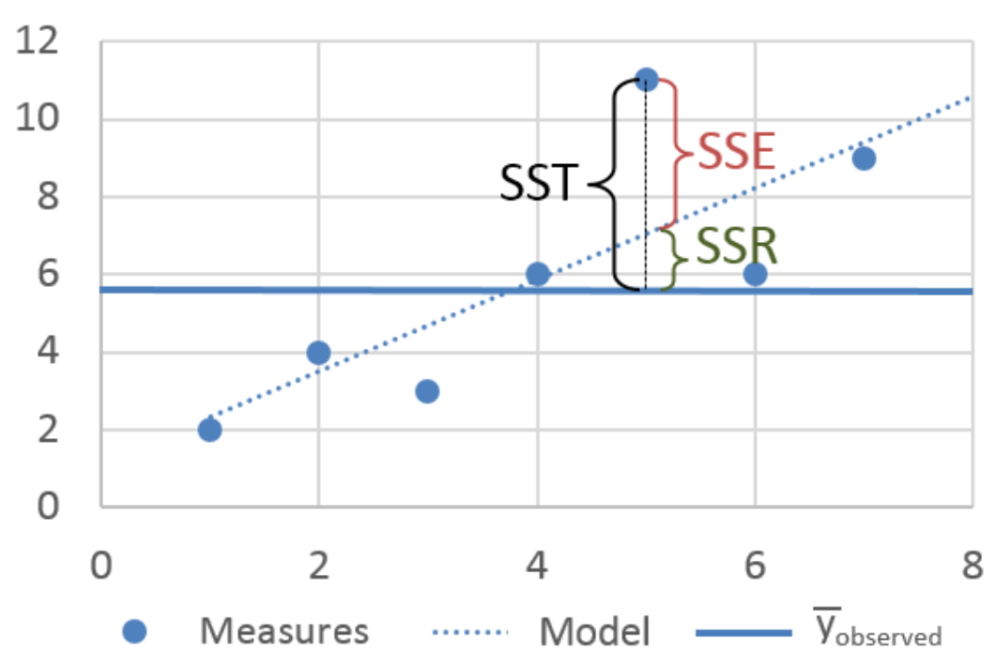
Partitioning Variability
img credit: Christian Gold

Slide 7
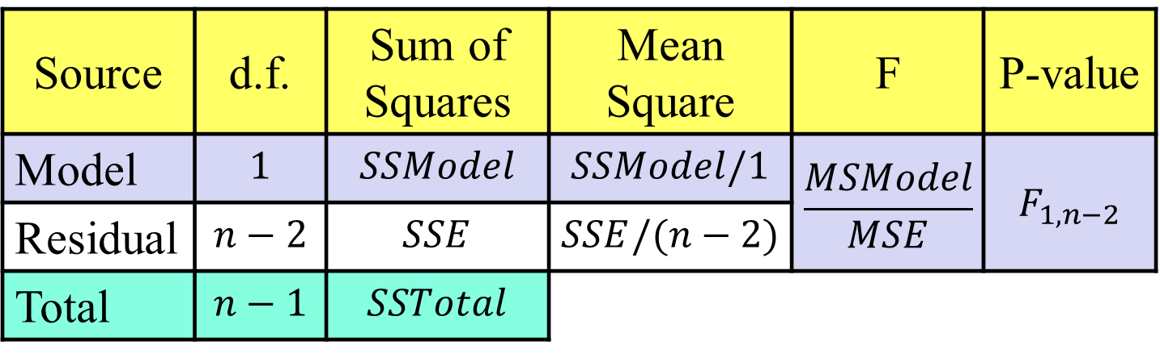
ANOVA Table
Classic Table
Degrees of Freedom and Sum of Squares for Total are Both a Summation of Values for Model and Residual
Source | d.f. | Sum of Squares | Mean Square | F | P-value
Model | $$1$$ | $$SSModel$$ | $$SSModel/1$$ | $$\frac{MSModel}{MSE}$$ | $$F_{1,n−2}$$
Residual | $$n−2$$ | $$SSE$$ | $$SSE/(n−2)$$
Total | $$n−1$$ | $$SSTotal$$

Slide 8

ANOVA Test for Simple Linear Regression
Equivalent to the t-Test for the Slope
Identical Hypotheses (in Simple Linear Regression)
Perform Simple Linear Regression and Obtain Table
Different Test Statistic
Compute p-value Based off F-Distribution and Not t-Distribution
F-distribution based off numerator degrees of freedom and denominator degrees of freedom
Decision and Interpretation is the Same (in SLR)
$$F^{∗}=\frac{SSModel/1}{SSE/(n−2)}=\frac{MSModel}{MSE}$$

Slide 9
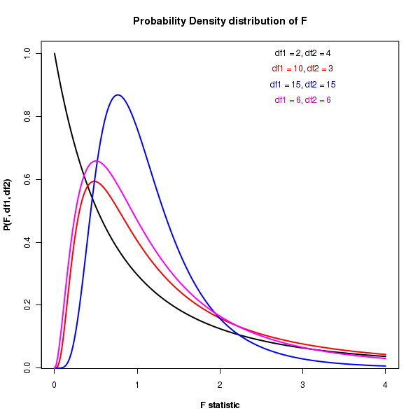
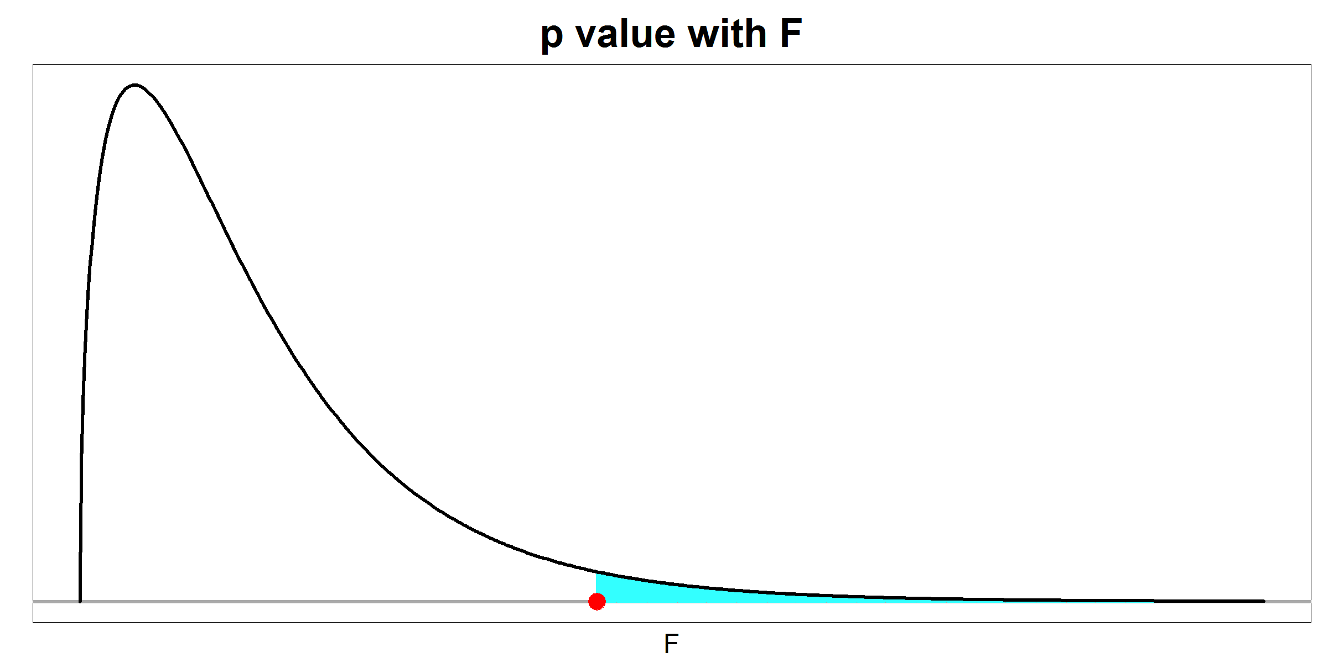

F-Distribution
Typically, Right Skewed
Used Typically When Test Statistic is a Ratio of Variances
P-value is shaded area
$$F^{∗}$$

Slide 10
Example: Fatalities
Question: Is there a linear relationship between the proportion of young drivers in a state and the number of vehicle fatalities in a state?
Data for States from 1982 Through 1988
From AER Package
fatal = Number of Vehicle Fatalities
youngdrivers = Percent of Drivers Aged 15 – 24 (inclusive)
Question: What is the problem with fitting a linear regression for the relationship fatal versus youngdrivers?

Slide 11
Supplement for Lecture 10
Conducting t-Test for Slope
Confidence Interval for Parameters
Getting ANOVA Table
Conducting F-test and Comparing Results

Slide 12
Thank You
Make Reasonable Decisions

